Slide 1

Communicating Science through Sci-Fi.
My recently published Science/Science fiction work
Dr Ranjan Garge
Former Principal
Government College of Arts and Science.
Aurangabad.

Slide 2
To create scientific awareness in this dynamic society
By simplifying and humanizing the scientific hard facts
Through easy communication
Science fiction story is one way.
What are the problems in Science communication ?

Slide 3
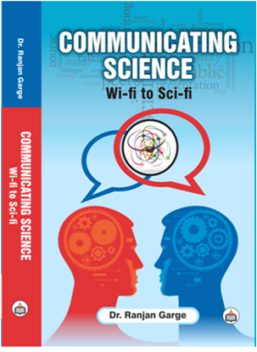

Slide 4
Communicating Science
330 pages
12 Chapters
Available on Amazon
This book elaborates about
What is Science ?
What is scientific enquiry ?
What type of training is required for good science writing?
Features of Science writing ?
Institutions engaged in science popularization.
Science fiction writing
I have raised a basic question
Where is a trained Science journalist ?

Slide 5
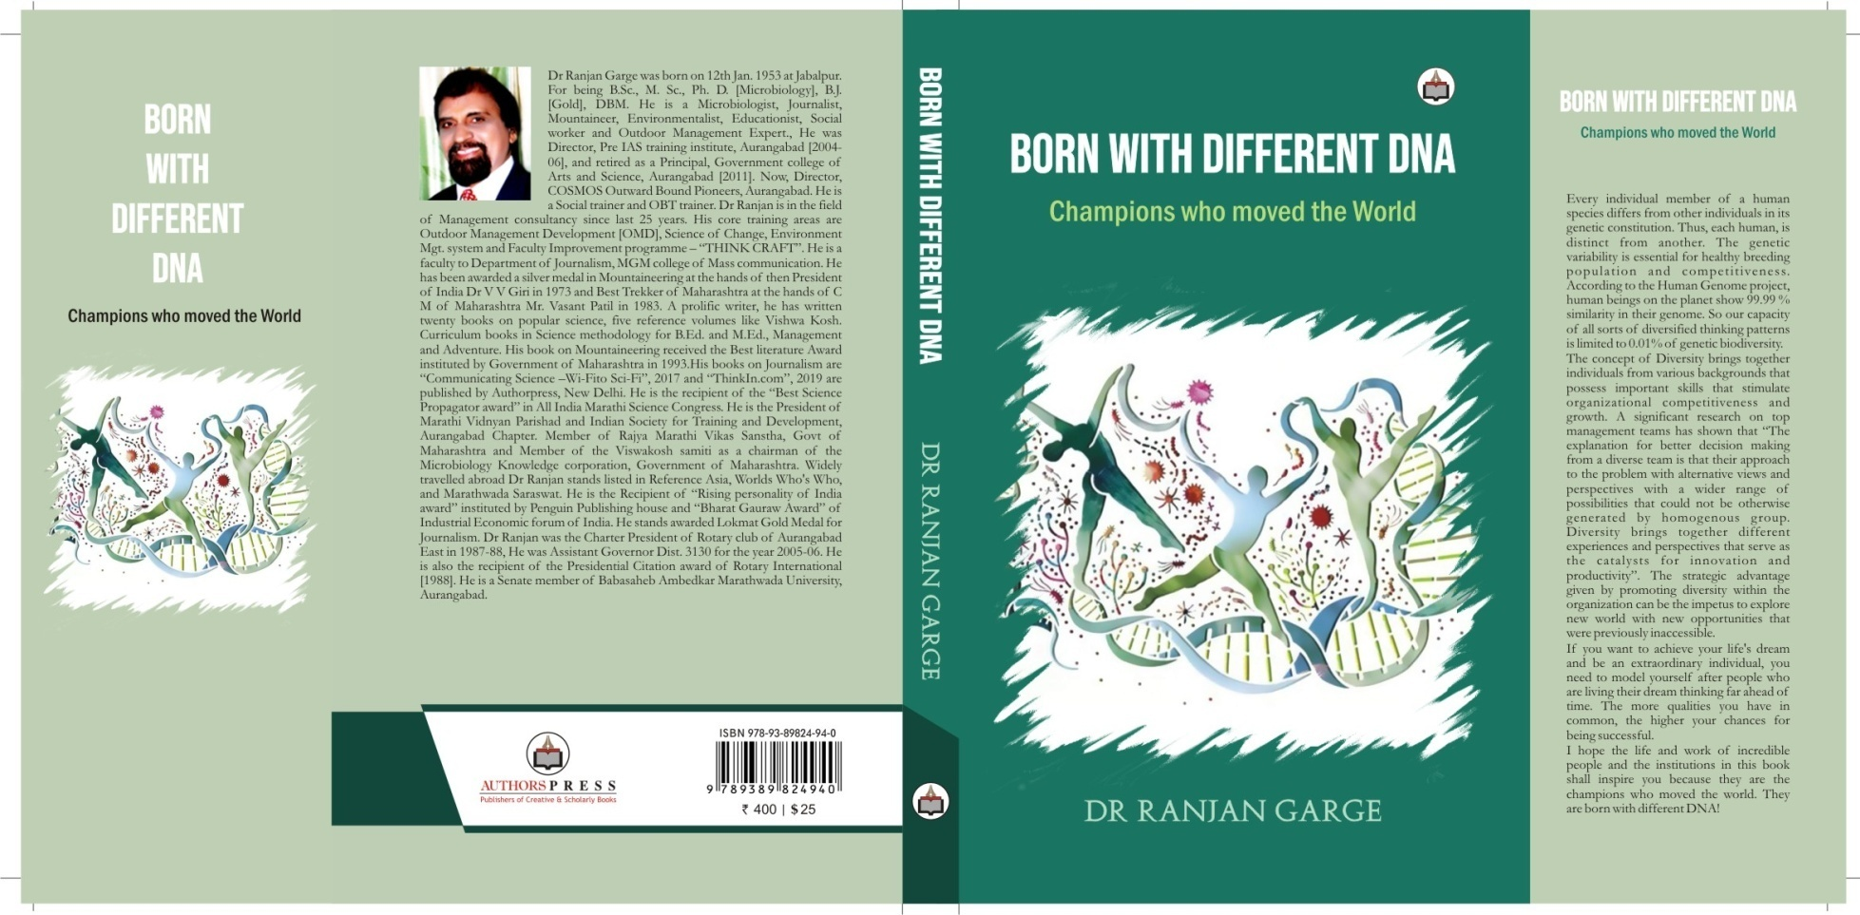
475 pages
2020
Available on Amazon

Slide 6
Diversity brings together different experiences and perspectives that serve as the catalysts for innovation and productivity
The genetic variability is essential for healthy breeding population A significant body of research on top management teams has shown that diversity leads to superior outcomes in decision making . “The explanation for better decision making from a diverse team is that their approach to the problem with alternative views and perspectives; this allows for a wider range of possibilities that could not be generated by homogenous group”

Slide 7
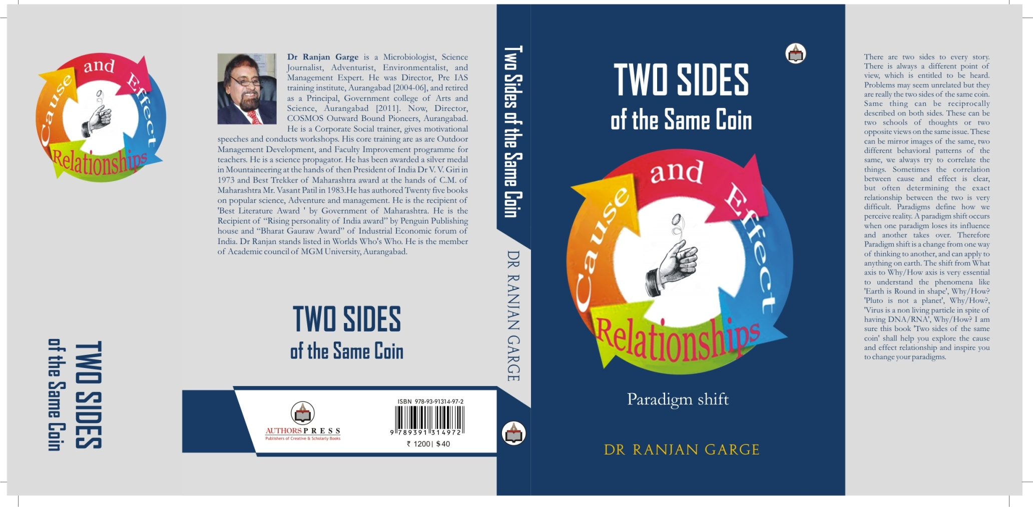
250 pages
2021

Slide 8
Two sides of the same coin
Paradigm shift
There are two sides to every story . There is always a different point of view, which is entitled to be heard. Same thing can be reciprocally described on both sides. These can be two schools of thoughts or two opposite views on the same issue. These can be mirror images of the same, Two different behavioral patterns of the same, We always try to correlate the things. Sometimes the correlation between cause and effect is clear, but often determining the exact relationship between the two is very difficult.
Paradigms define how we perceive reality. A paradigm shift occurs when one paradigm loses its influence and another takes over. Therefore Paradigm shift is a change from one way of thinking to another, and can apply to anything on earth.

Slide 9
The shift from What axis to Why/How axis is very essential to understand the phenomena like ‘Earth is Round in shape’ , Why/How ? ‘Pluto is not a planet’ , Why/How ? , ‘Virus is a non living particle in spite of having DNA/RNA’, Why/How ?
I am sure this book ‘Two sides of the same coin’ shall help you explore the cause and effect relationship and inspire you to change your paradigms.

Slide 10
Problems of Science communication

Slide 11
PROBLEMS
1.
Currentness :
Discoveries do not happen overnight.

Slide 12
2
Handling scientific terms
1.Stylistic FOG of scientific terms
Latin , Greek , German.
2.Reading is increasingly difficult as the fog index rises.
3.Minimum use of complicated sentences.
4.For a new term or definition , explanation should follow.

Slide 13
3
Many scientists write badly !
1.Do they know too much of science.?
2.Do they know too many technical words.?
3. Have they never been trained to write simply ?

Slide 14
4
AN ART !
1. Writing simply and clearly.
Requires practice and intelligent thought.
2. Thorough understanding of basic principles of science.
3. Requires special study in limited area.

Slide 15

5
Borrowing scientific brain
1. Skill of interviewing a qualified expert.
Requires advanced reading and study.
2. 2nd and 3rd call back is necessary.
3. Take interviewee’s word and finalize.

Slide 16
6
Simplification and specialization
Language of man in street.
Limited range of vocabulary.
Must understand style , vocabulary , space and time.
Must specialize in one field or fields closely allied.
Self directed plan for increased mastery of simplification and humanization

Slide 17
7
Level of popularization
1. News papers with mass circulation
[For common man and no detailed news]
2. Magazines and books with reader level well above the popular science
[Read by limited group wanting detailed news.]

Slide 18
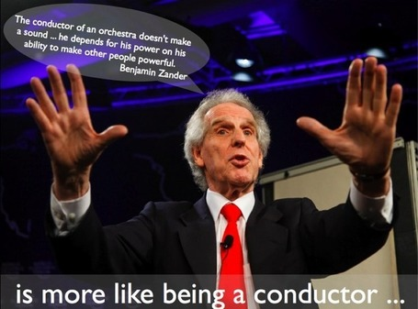


ORAL
[Clean , Clear , Correct]
PRESENTATION SKILLS
WRITTEN
[Professional , Persuasive , Effective]
ELECTRONIC
[Alert , Responsive , Interactive]

Slide 19
Science fiction contains the unusual setting of the story.
1.A specific futuristic setting,
It relies heavily on scientific facts, theories, and principles as support for its settings
2.character development,
3.plot (central conflict, Un-curable disease, Genetic Engineering, complications, climactic events, IVF, Cloning),
4.themes,
5.structure.

Slide 20
My recently published Science Fiction work
मंगळ कुजबुजला
[Magal Kujbujala]
1. Life on Mars 2. Anthropology 3. Reproductive physiology

Slide 21


Slide 22
मंगळ कुजबुजला
[Magal Kujbujala]
It contains three long stories which revolve around Mars.
मंगळ कुजबुजला Indian astronauts successfully identify the presence Of life on Mars.
They are being Hijacked from Mars to some other planet in Dhruv Solar system. …….
होमो-मर्शियन : Damaged Brain is discovered during excavation on Mars. Brought on earth.
Missing DNA links are obtained from Namibian tribes. Complete brain is cloned .Scientists
Make that brain speak in a specially coded language. Accordingly fossils are obtained
on skeleton island in Namibia. New Homo-sapiens are discovered . In the end The brain
speaks in front of scientists throughout the world and declares the name of this new
missing species in the course of evolution as ‘Homo-marshian”
दि न्यूड्स : Viral disease makes the men on the planet Avani from Vyadh solar syastem
impotent but females are Fertile. Now they want to start natural reproduction .
They find earth to have highly Potent men. They Hijack a young honeymoon couple.
They travel intergalactic distances through wormhole. Eliens treat them with respect.
Get the females conceived. ……….

Slide 23
Coming up soon
बिजांकुर
[Bijankur]
Cloning , IVF , Gene therapy ,
DNA modeling,
Global warming , Head transplant , Phantom pain
?

Slide 24


